Slide 1


Organizational DNA
A research-based diagnostic and development system that identifies why change efforts succeed or fail and builds organizational capacity for transformation—regardless of the specific initiative.

Slide 2
Why do initiatives fail?
Notes:
Learning Arc Stage: ACTION PLANNING & COMMITMENT
2:45-3:00 | Determining Your Limiting Factor (15 min)
Purpose: Apply the Theory of Constraints to organizational resonance—identify the bottleneck.
In any multiplicative system, improvement in the weakest dimension yields the greatest return. Your limiting factor is your lever for transformation.
Guided Analysis:
Review your dimension scores:
Which dimension scored lowest?
Is there a dimension approaching zero (below 30)?
Consider variance:
Large spread between dimensions indicates discord (e.g., Lens=80, Rhythm=20)
Variance > 30 points = significant misalignment
Check Foundation:
If Foundation < 40, this MUST be addressed first—nothing else will work without it
Name your limiting factor: The dimension that most constrains your transformation

Slide 3
Experts in their Respective Fields
Elena Aguilar
Shawn Anchor
Chris Argyris
Bolman & Deal
William Bridges
Brene Brown
Tim Brown
James Clear
Jim Collins
Arthur Costa
Stephen Covey
Daniel Coyle
Angela Duckworth
Richard DuFour
Carol Dweck
Amy Edmonson
Dean Fixsen
Michael Fullan
Malcolm Gladwell
Adam Grant
John Hattie
Joyce & Showers
Daniel Kahneman
Kim Knight
Malcolm Knowles
David Kolb
John Knotter
Patrick Lencioni
Kurt Lewin
David Marquet
John Maxwell
Chris McChesney
Donella Meadows
Daniel Pink
David Rock
Everett Rogers
Edgar Schein
Peter Senge
Simon Sinek
James Spillane
John Sweller
Victor Vroom
Micheal Walkins

Slide 4
Behavioral Implementation Science
Behavioral Implementation Science is the study of how psychological, social, and contextual factors influence the adoption, integration, and sustainability of evidence-based practices in real-world settings. It applies insights from behavioral economics, cognitive psychology, and social science to close the gap between knowing and doing.
Notes:
Behavioral Implementation Science applies what we know about human behavior—habits, motivation, cognitive load, social influence—to the challenge of getting evidence-based practices into consistent classroom use. It addresses why 90% of professional development fails to transfer and what conditions make the other 10% succeed. Behavioral Implementation Science examines why people struggle to put good ideas into practice—and what actually helps change stick. It blends behavior change research with implementation strategy to solve the "knowing-doing gap."

Slide 5

DNA DOESN’T ADD ITS COMPONENTS TOGETHER.
THE SEQUENCE MATTERS.
THE COMBINATIONS MATTER.
WHEN YOU ALIGN ALL
DIMENSIONS, SMALL EFFORTS MULTPLY INTO BREAKTHROUGH RESULTS.
Notes:
Purpose: Introduce the transformation formula and multiplicative principle.

Slide 6

Culture, Climate & Conditions for Success
Notes:
Purpose: Introduce the transformation formula and multiplicative principle.

Slide 7
Mission
IMSE’s mission is to empower districts, schools, teachers, and parents to be agents of change toward equitable literacy instruction for all learners that is driven by research.
LEADING QUESTION | KEY OUTCOME
How do we do things here? | Trust, norms, learning structures, collective efficacy
How does it feel right now? | Safety, energy, engagement, capacity for change
How do we make this happen? | Diagnosis, coalitions, execution, scorecard, integration
Notes:
Trust & Purpose – The bedrock enabling all transformation
Psychological safety—can take risks without punishment
Shared purpose—compelling 'why' that resonates
Trust built through vulnerability and reliability

Slide 8
Seeing the Big Picture
Culture
How we do things here
Relational Infrastructure
Operating Norms
Undercurrents
Learning Architecture
Collective Capabilities
Climate
How things feel right now
Psychological Safety
Strategic Priority Focus
Energy & Morale
Adult Engagement
Tension & Pushback
Conditions for Success
Making it happen and making it stick
Diagnostic Clarity
Coalition Building
Sustained Execution
Systems Integration
The Scorecard
Develops One Wildly Important Goal with Lasting Transformation

Slide 9
Identify the Bottleneck
Improvement in the weakest dimension yields the greatest return.
Your limiting factor is your lever for transformation.
Notes:
Learning Arc Stage: ACTION PLANNING & COMMITMENT
2:45-3:00 | Determining Your Limiting Factor (15 min)
Purpose: Apply the Theory of Constraints to organizational resonance—identify the bottleneck.
In any multiplicative system, improvement in the weakest dimension yields the greatest return. Your limiting factor is your lever for transformation.
Guided Analysis:
Review your dimension scores:
Which dimension scored lowest?
Is there a dimension approaching zero (below 30)?
Consider variance:
Large spread between dimensions indicates discord (e.g., Lens=80, Rhythm=20)
Variance > 30 points = significant misalignment
Check Foundation:
If Foundation < 40, this MUST be addressed first—nothing else will work without it
Name your limiting factor: The dimension that most constrains your transformation

Slide 10
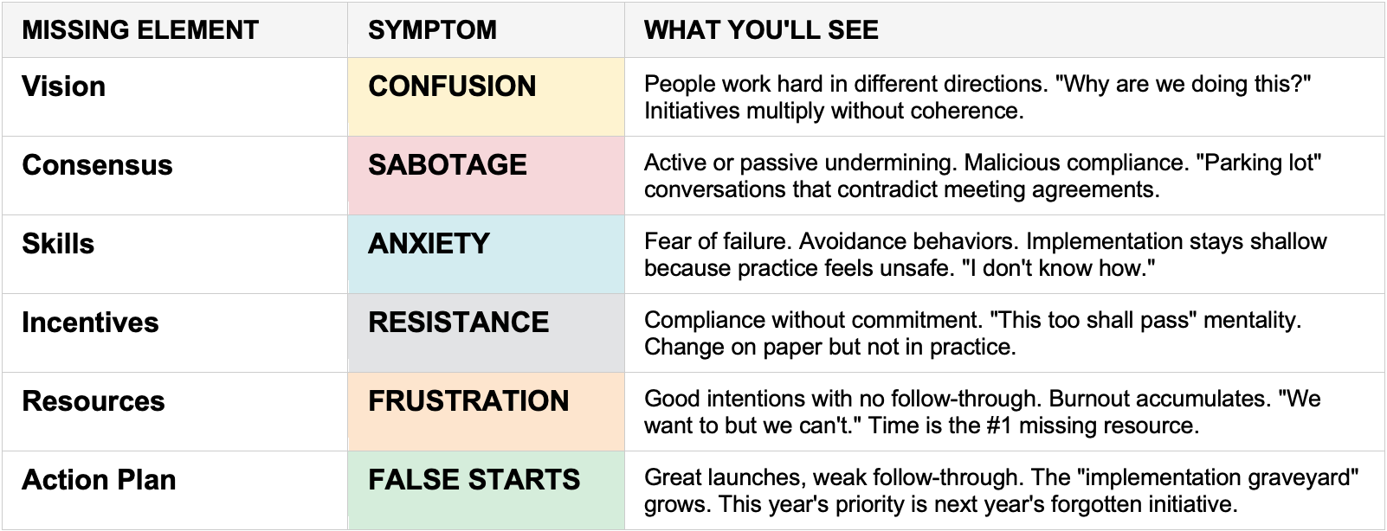
Lippitt-Knoster Model

Slide 11
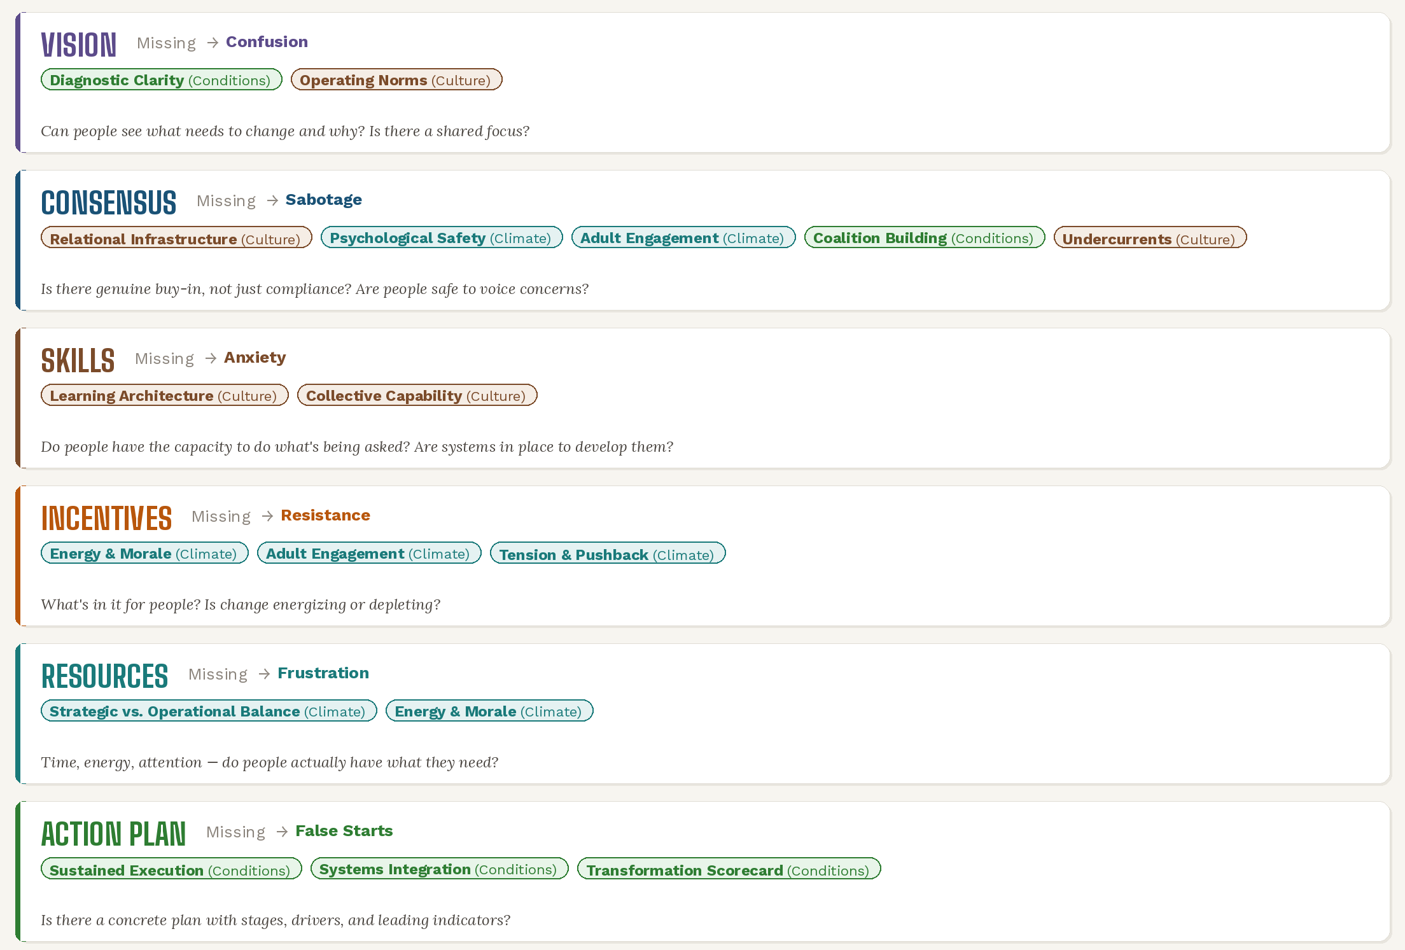

Slide 12
1
Understand the Framework
2
Thoroughly Assess
3
Implement Strategies
4
Update Scorecard
5
Iterate Over Time

Slide 13
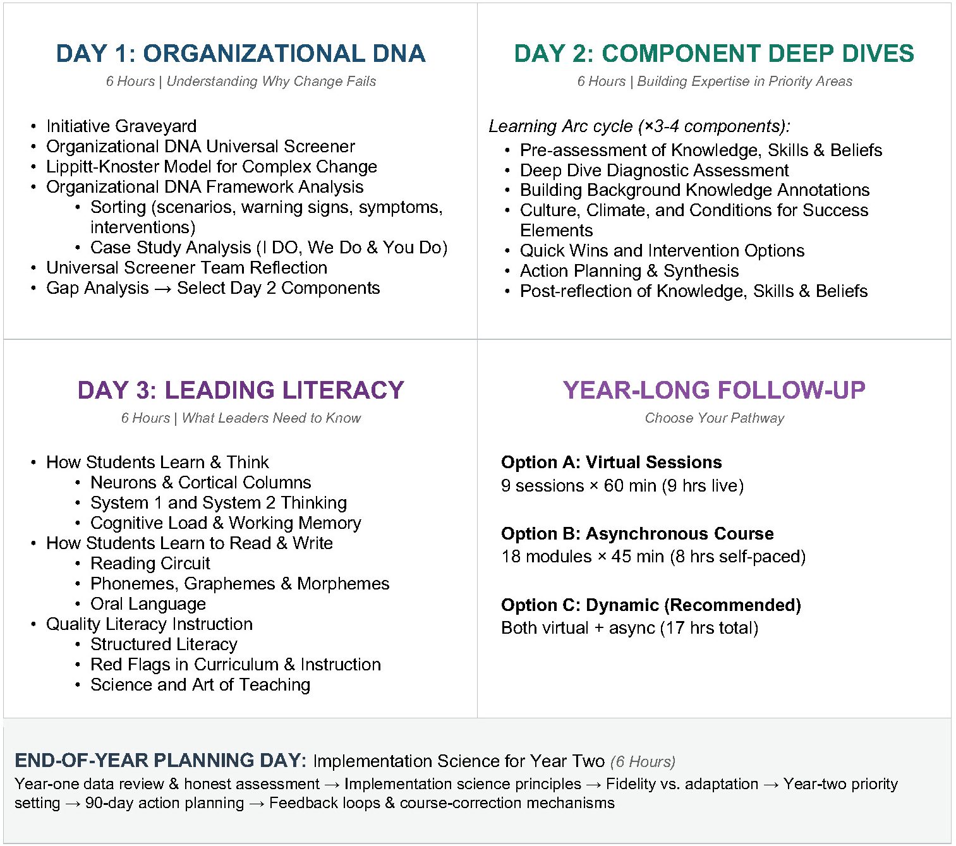
Professional Development
Notes:
Learning Arc Stage: ACTION PLANNING & COMMITMENT
2:45-3:00 | Determining Your Limiting Factor (15 min)
Purpose: Apply the Theory of Constraints to organizational resonance—identify the bottleneck.
In any multiplicative system, improvement in the weakest dimension yields the greatest return. Your limiting factor is your lever for transformation.
Guided Analysis:
Review your dimension scores:
Which dimension scored lowest?
Is there a dimension approaching zero (below 30)?
Consider variance:
Large spread between dimensions indicates discord (e.g., Lens=80, Rhythm=20)
Variance > 30 points = significant misalignment
Check Foundation:
If Foundation < 40, this MUST be addressed first—nothing else will work without it
Name your limiting factor: The dimension that most constrains your transformation

Slide 14
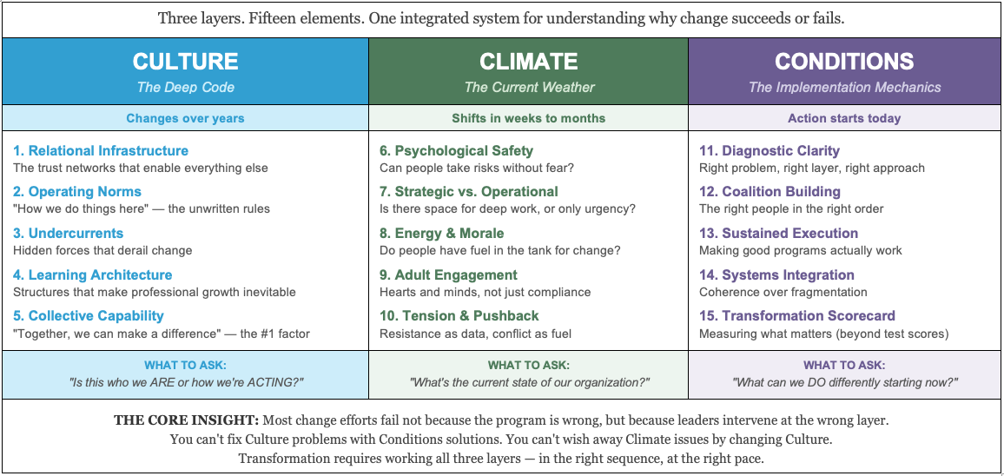
Organizational DNA

